Slide 1
Phishing Detection with Browser Extension Based on Machine Learning
Mayank Sachin Chougale
2022BCS076
A Cryptography and Network Security End Term Project Under the guidance of Ms. Misha Nihalani

Slide 2
Table of contents
01
03
05
02
04
Project Methodology
Future Scope & Conclusion
Introduction
Abstract
Literature Review
System Implementation
04

Slide 3
Abstract
Phishing attacks have become one of the most common and dangerous cyber threats, aiming to deceive users into revealing sensitive information such as passwords, banking details, or personal data. Traditional detection techniques like blacklists and rule-based filters often fail to identify newly created or sophisticated phishing sites. To overcome these limitations, this project proposes a browser extension integrated with a machine learning–based phishing detection system.
The proposed system continuously monitors URLs and webpage content visited by the user and extracts key features. These features are then analyzed using a trained machine learning model—for example, Random Forest, Support Vector Machine (SVM), or Logistic Regression—to classify websites as legitimate or phishing in real time.
The browser extension acts as a user-friendly front end, alerting users whenever a suspicious website is detected and preventing them from entering confidential information. This approach enhances online security by providing an intelligent, adaptive, and lightweight defense mechanism against phishing attacks. The integration of machine learning enables the system to learn and improve over time, ensuring better accuracy and adaptability to evolving phishing techniques.

Slide 4
Introduction
With the rapid growth of the Internet, users perform most activities such as banking, shopping, and communication online.
This increased digital dependence has also led to a rise in phishing attacks, where attackers create fake websites to steal users’ confidential information.
Despite several existing security mechanisms, traditional detection methods like blacklists or manual reporting fail to detect new or evolving phishing sites effectively.
To address this issue, integrating Machine Learning (ML) with a browser-based detection system provides an intelligent and real-time solution.
This project aims to develop a browser extension that leverages ML algorithms to analyze website features and instantly warn users of potential phishing threats.

Slide 5
Literature Review
Several research studies have focused on developing intelligent solutions for detecting phishing attacks using machine learning techniques. Wu, Kuo, and Yang from the National Cheng Kung University proposed a phishing detection framework that integrates a browser extension with a machine learning–based classifier to identify phishing websites in real time.
Their system extracts URL and webpage source code features and employs algorithms such as Support Vector Machines (SVM) and Random Forest to achieve high detection accuracy while minimizing false positives.
Earlier, the same authors presented a machine learning–based phishing detection model that used URL similarity measures like Levenshtein Distance to classify malicious websites effectively. Later improvements included implementing the model within a browser extension, thereby demonstrating the feasibility of real-time protection.
Other researchers have also explored similar methods, emphasizing that traditional blacklist approaches are insufficient against newly generated phishing sites, and that adaptive, learning-based systems provide better resilience. Overall, existing literature highlights the importance of combining feature-based machine learning models with user-friendly browser extensions to offer proactive, accurate, and real-time phishing detection mechanisms.

Slide 6
Project Methodology
Step 1
Gather Data for model training
Step 2
Preprocessing of Data
Step 3
Model Training and performance evaluation
Step 4
Deployment as browser extension

Slide 7
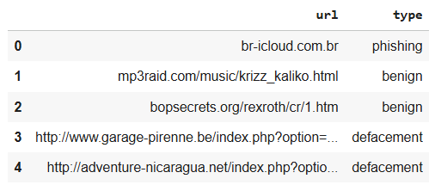
01
Gathering Data
Project Methodology
Dataset is taken from kaggle “sid321axn/malicious-urls-dataset”

Slide 8
02 Preprocessing
Project Methodology
Removing Null Values
URL Normalization
Label Encoding
Feature Extraction
Eliminate missing or duplicate URLs to ensure data consistency
Converting all URLs to lowercase & removing unnecessary symbols
Converting target class labels to numeric form
Extract numerical and categorical features from URLs

Slide 9
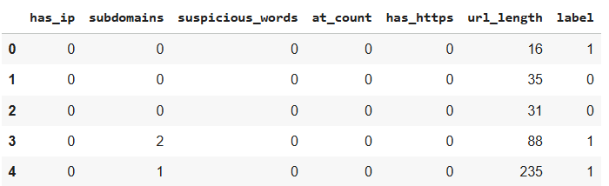
02 Preprocessing
Project Methodology
Feature Extraction
Extract numerical and categorical features from URLs such as:
URL length
Number of dots (.)
Presence of “@”, “-”, “https” or “IP address” in URL
Domain length, subdomain count, special characters, etc.

Slide 10
03
Model Training
Project Methodology
The dataset is divided into training (80%) and testing (20%) sets using train_test_split from sklearn.model_selection.
Logistic Regression is chosen as the machine learning model for phishing detection.
The model is trained on the training data using:
model.fit(X_train, y_train)
Model performance is evaluated using the classification report, which provides precision, recall, F1-score, and accuracy metrics.
After successful training, the model parameters such as coefficients and intercept are saved in a JSON file for future use (e.g., integration with the browser extension).

Slide 11
Deployment as Browser Extension
Project Methodology
04
The trained Logistic Regression model is exported as a JSON file containing its coefficients and intercept.
The browser extension captures the current webpage URL whenever a user visits a site.
The extension’s background script extracts features from the URL (like length, special characters, presence of “@”, etc.).
These features are passed to the deployed model (from JSON), which calculates a prediction score.
Based on the score and threshold (e.g., 0.5), the site is classified as phishing, benign, defacement, or malware.
If detected as suspicious, the extension alerts the user in real time through warning message.

Slide 12
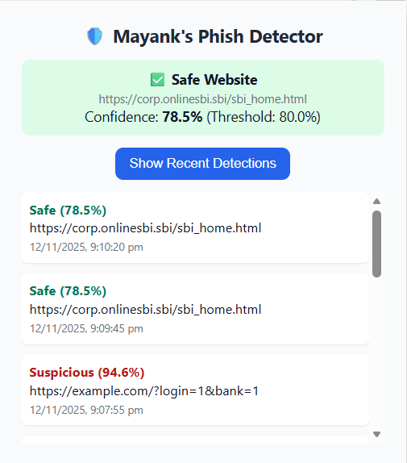
System Implementation
The system is implemented as a browser extension that integrates the trained machine learning model for real-time phishing detection.
The extension consists of three main components: background script, content script, and popup interface.
The background script continuously monitors the URLs of websites visited by the user.
When a new URL is detected, the extension extracts key features such as domain length, presence of symbols etc.
These features are then passed to the machine learning model, stored in JSON format, which predicts whether the website is benign, phishing, defacement, or malware.
Based on the prediction, the extension provides instant feedback to the user through a popup or alert message. This setup ensures lightweight, real-time phishing detection directly in the browser without needing external servers, making it both efficient and user-friendly.

Slide 13
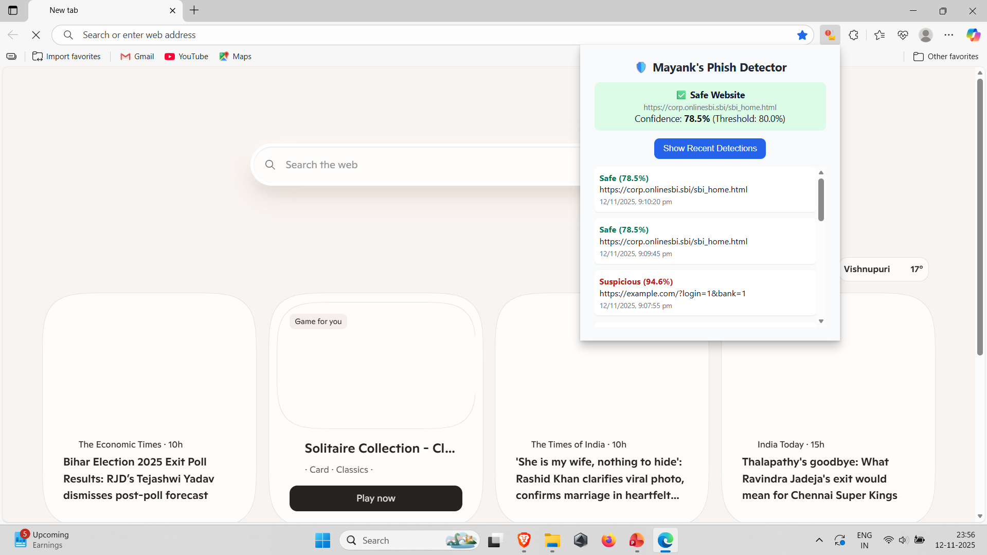

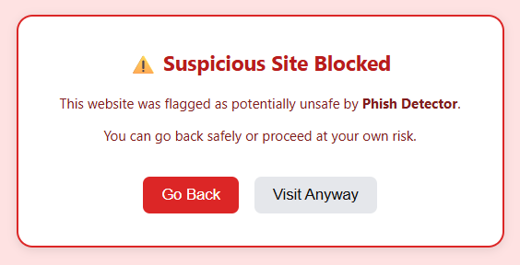
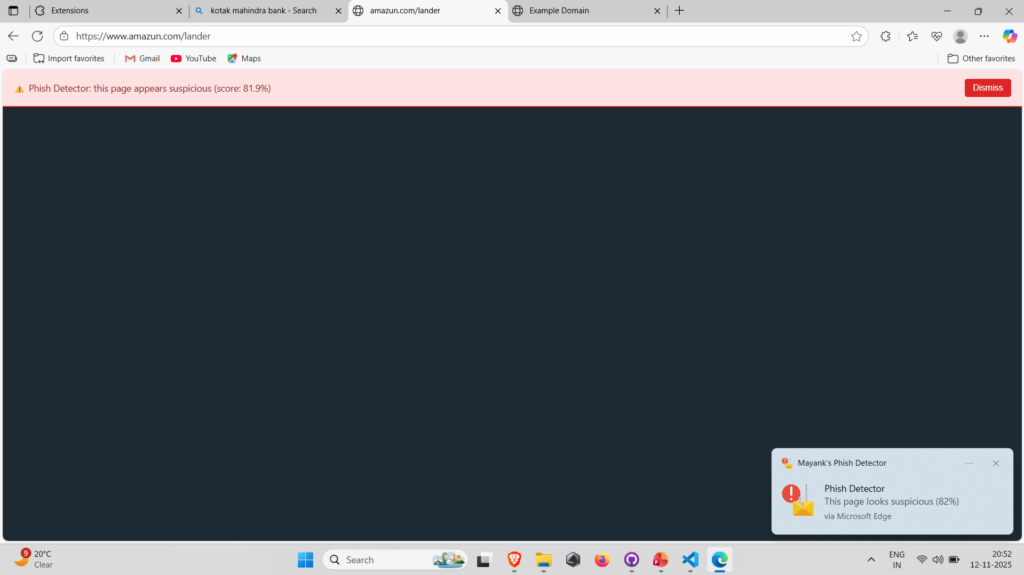
System Implementation

Slide 14
Conclusion & Future Scope
The proposed system successfully demonstrates a machine learning–based phishing detection mechanism integrated within a browser extension.
By analyzing URLs and webpage features in real time, the extension effectively classifies websites as benign, phishing, defacement, or malware.
It provides instant alerts, blocks suspicious pages, and ensures a safer browsing experience for users.
The system proves that combining lightweight ML models with browser-based deployment offers an efficient and user-friendly defense against evolving phishing threats.
In the future, the system can be enhanced by integrating deep learning models for improved accuracy and faster detection. Continuous learning mechanisms can be added so the model updates automatically with new phishing data.
The extension can also be expanded to support multiple browsers (e.g., Chrome, Edge, Firefox) and include real-time database updates for blacklisted URLs. Additional features like user feedback collection, multi-language alerts, and cloud-based analytics can further strengthen the system’s performance and adaptability.

Slide 15
References
Che-Yu Wu, Cheng-Chung Kuo, and Chu-Sing Yang, “Phishing Detection with Browser Extension Based on Machine Learning,” 2023 IEEE International Conference on Information Security and Intelligence Control (ISIC), National Cheng Kung University, Tainan, Taiwan.
Che-Yu Wu, Cheng-Chung Kuo, and Chu-Sing Yang, “A Phishing Detection System Based on Machine Learning,” IEEE Conference on Dependable and Secure Computing, 2019.
Tang, S., Chen, L., & Huang, J., “A Survey on Machine Learning-Based Phishing Website Detection,” Journal of Cybersecurity and Privacy, MDPI, 2021.
Adake, P., et al., “Real-Time Phishing Website Detection using Machine Learning and User Feedback,” International Journal of Recent Technology and Engineering (IJRTE), 2023.
Scikit-learn Documentation, “Logistic Regression and Model Evaluation Tools,” https://scikit-learn.org/
Google Chrome Developers, “Manifest V3: Building Browser Extensions,” https://developer.chrome.com/docs/extensions/

Slide 16
Thank You

